Slide 1
Մաս 5

Slide 2
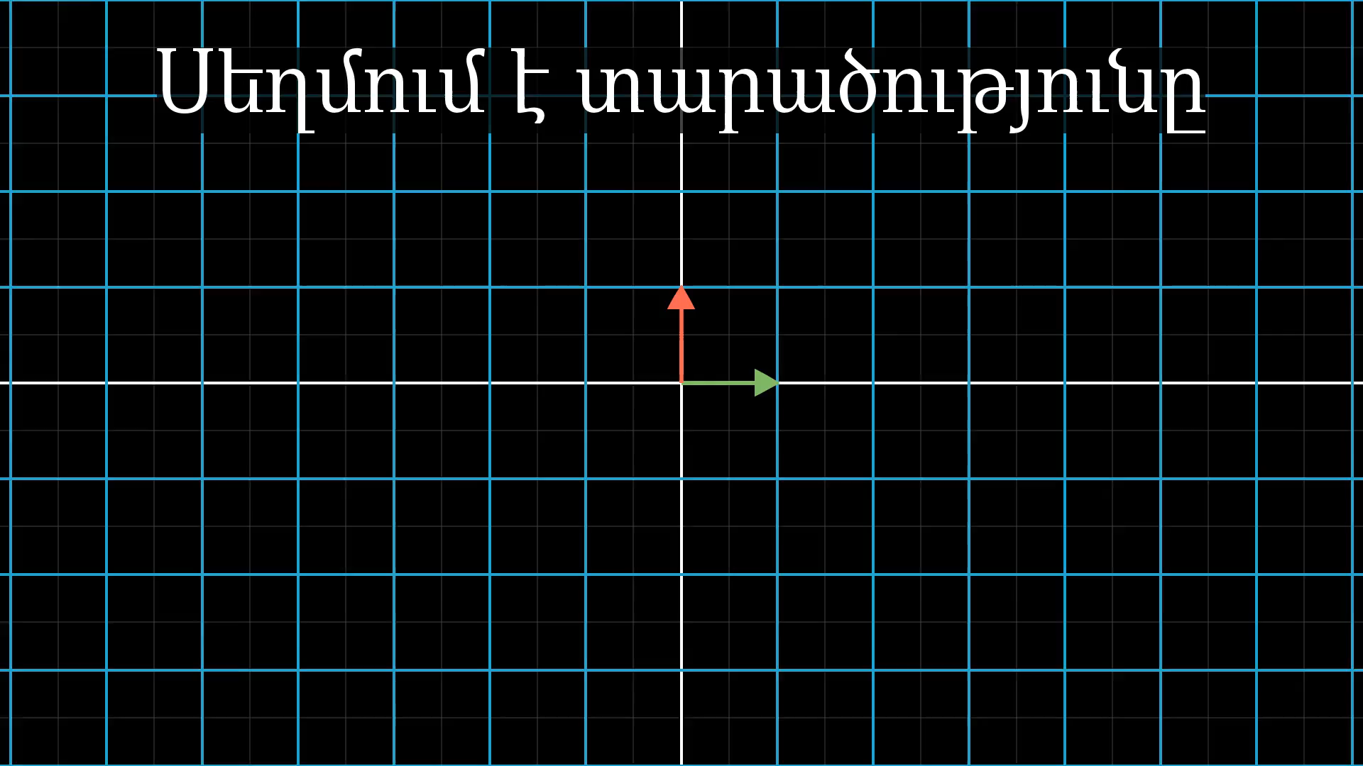
Notes:
Squishing transformation

Slide 3
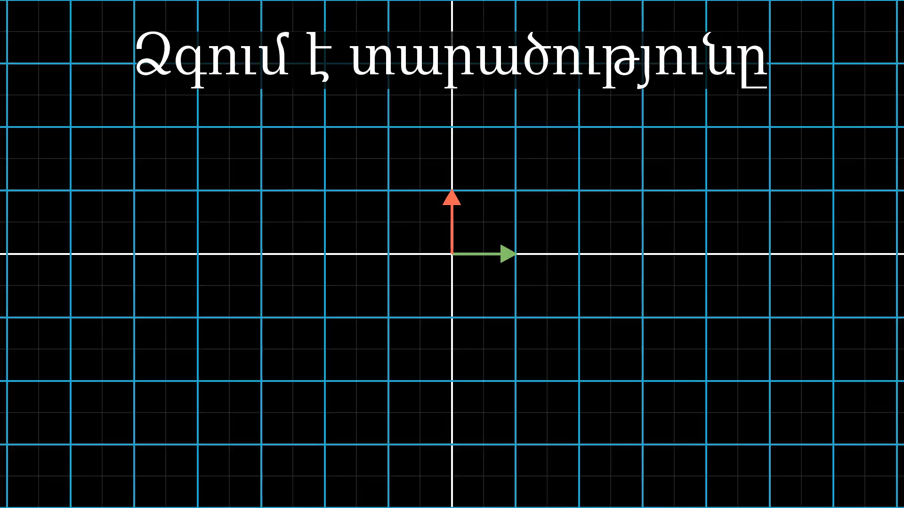
Notes:
Stretching transformation

Slide 4
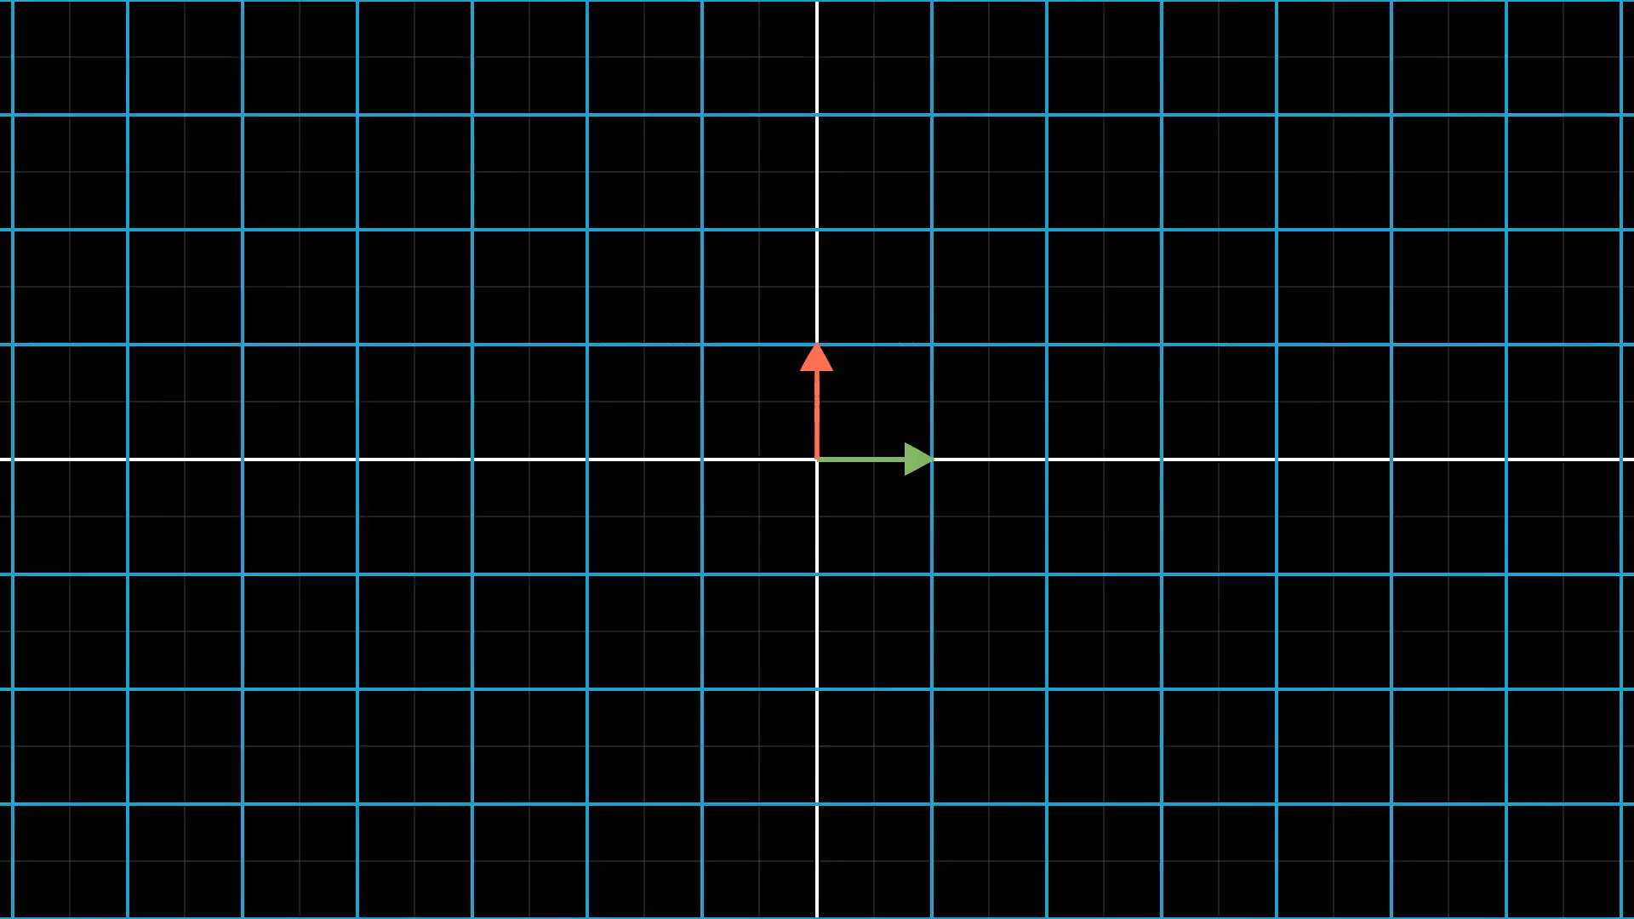
Notes:
Ask about stretching

Slide 5
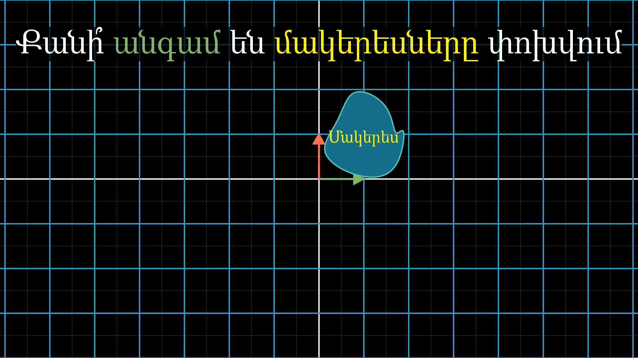
Notes:
Ask about stretching specifically

Slide 6
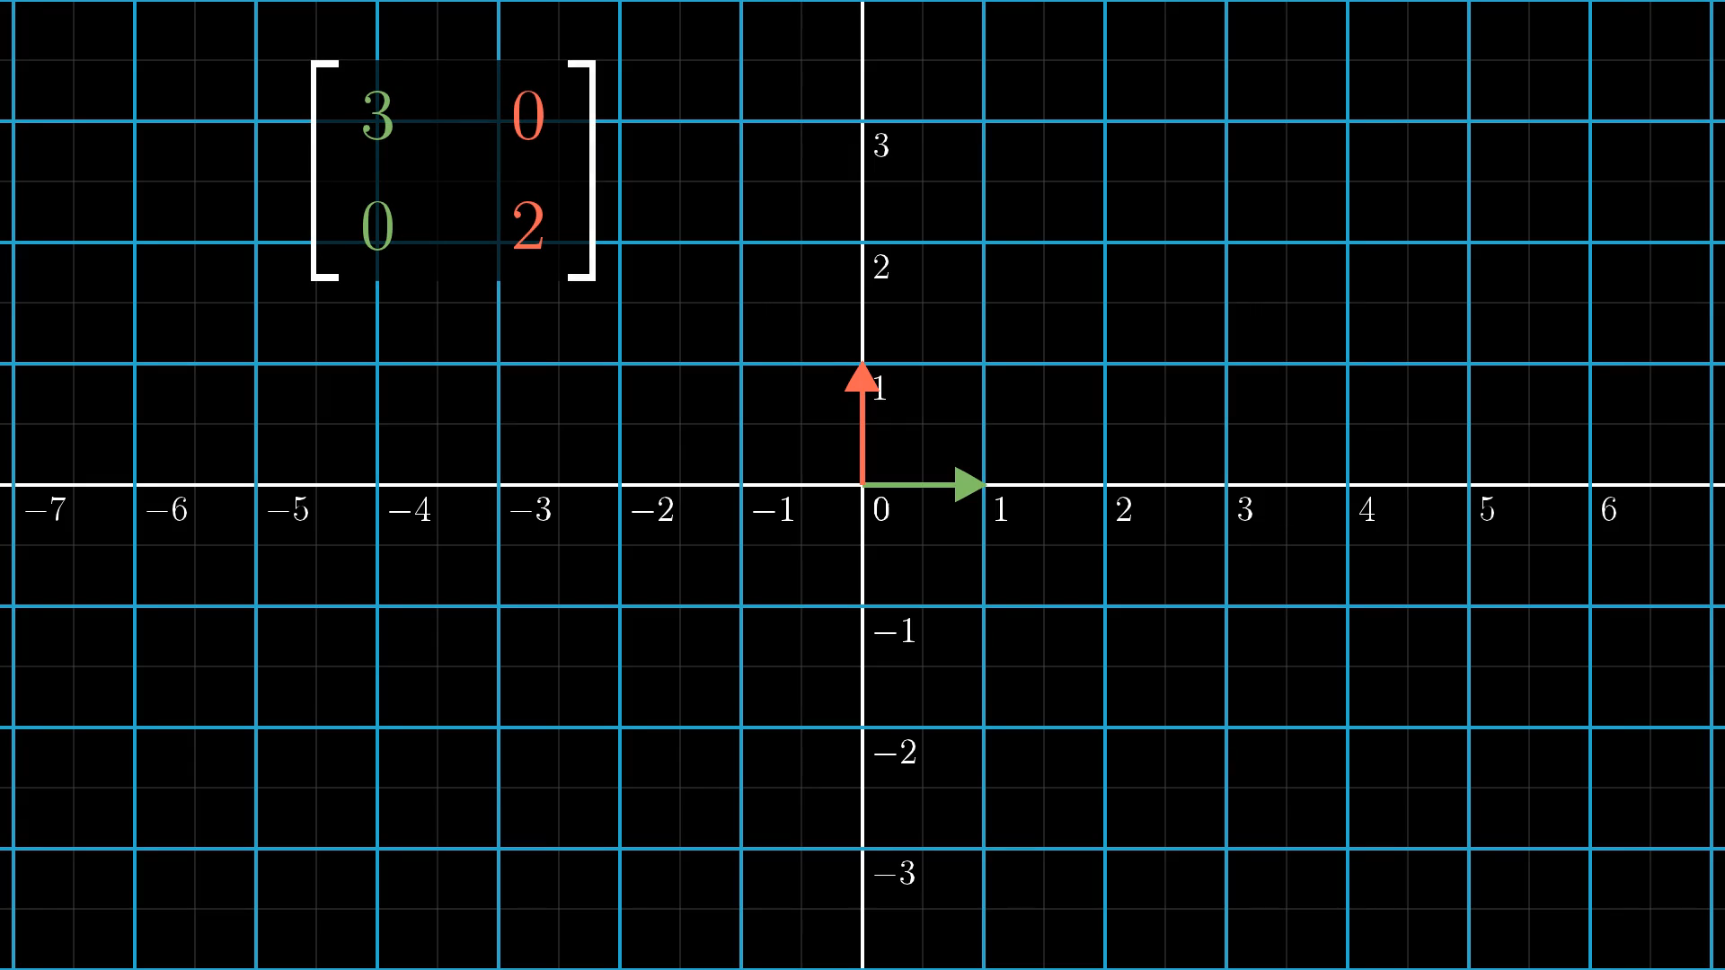
Notes:
Diagonal example

Slide 7
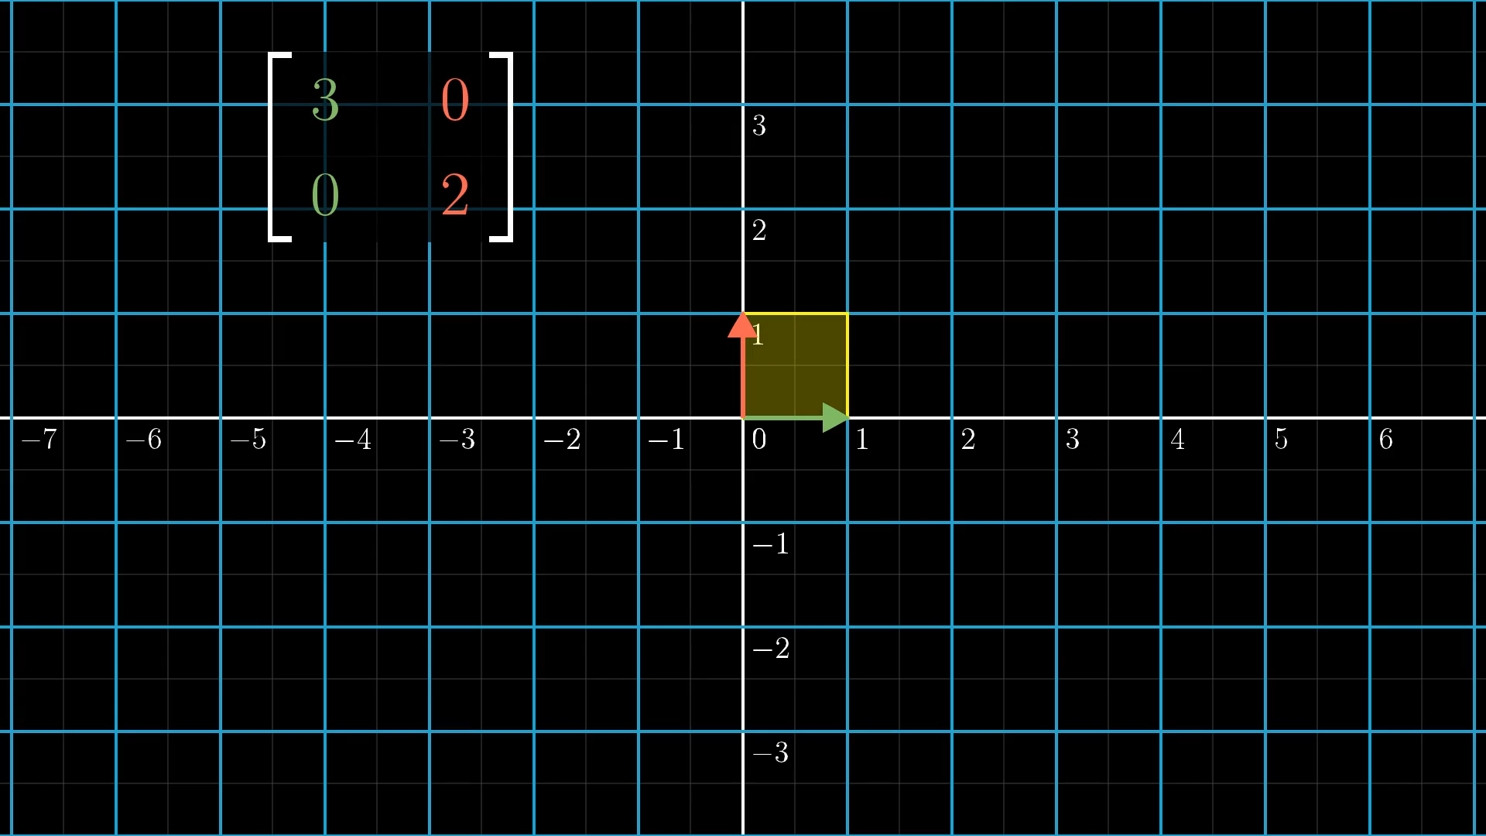
Notes:
Diagonal example with square

Slide 8
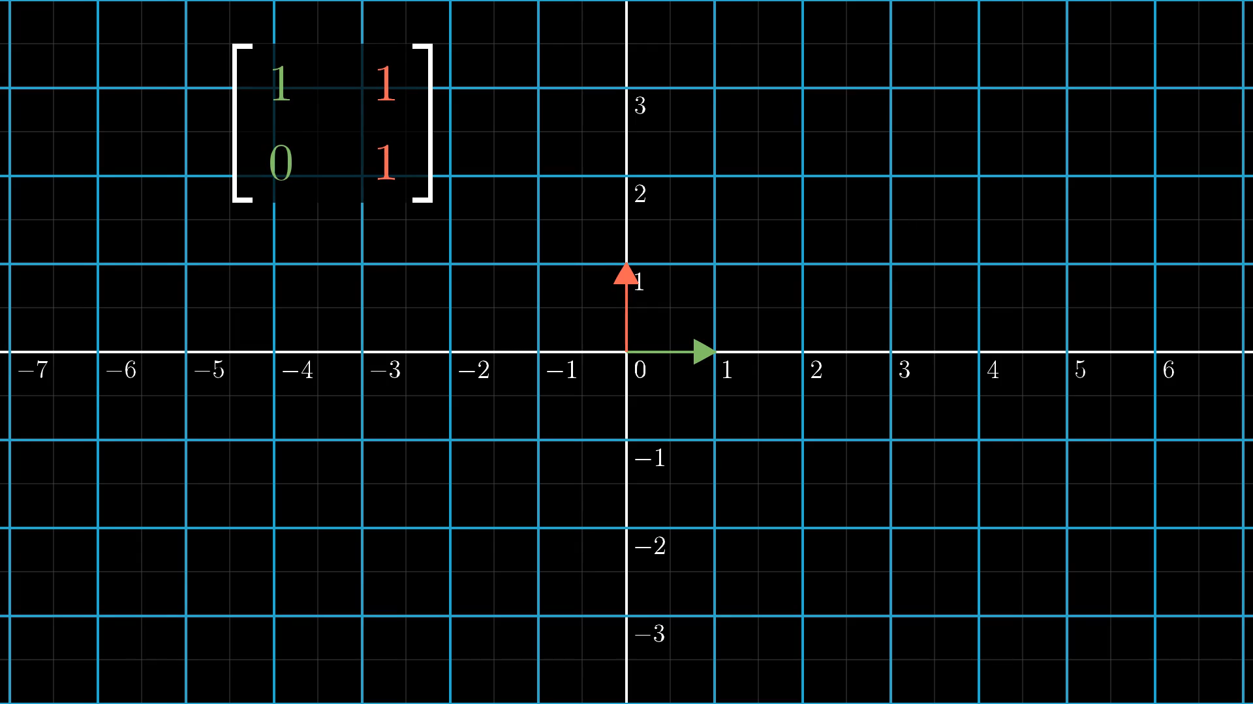
Notes:
Shear example

Slide 9
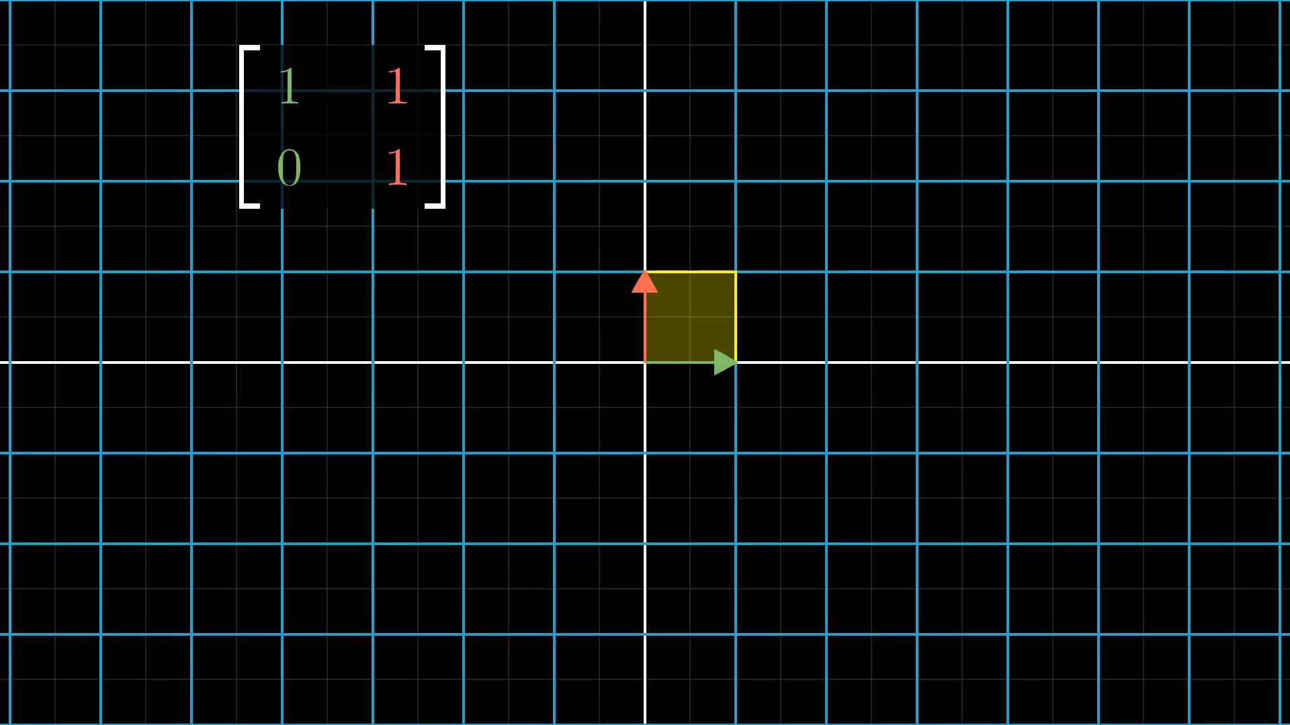
Notes:
Shear example with square

Slide 10
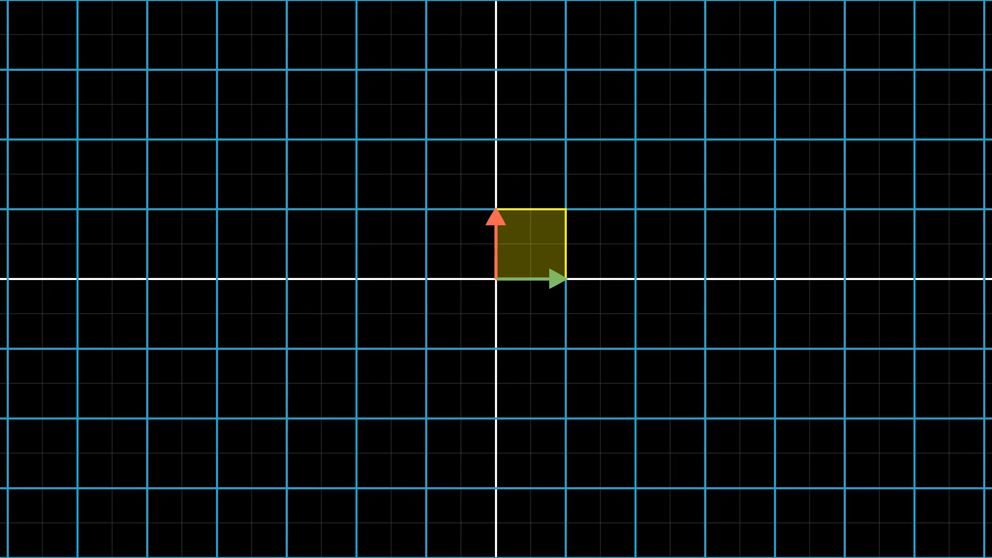
Notes:
This square tells everything

Slide 11
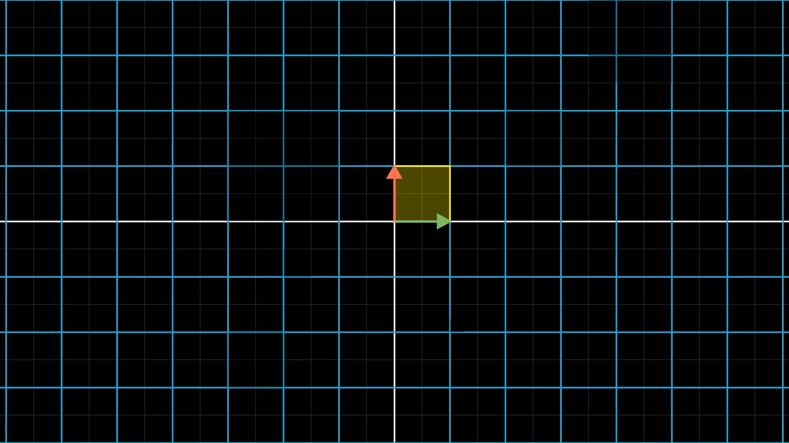
Notes:
Same thing happens to all

Slide 12
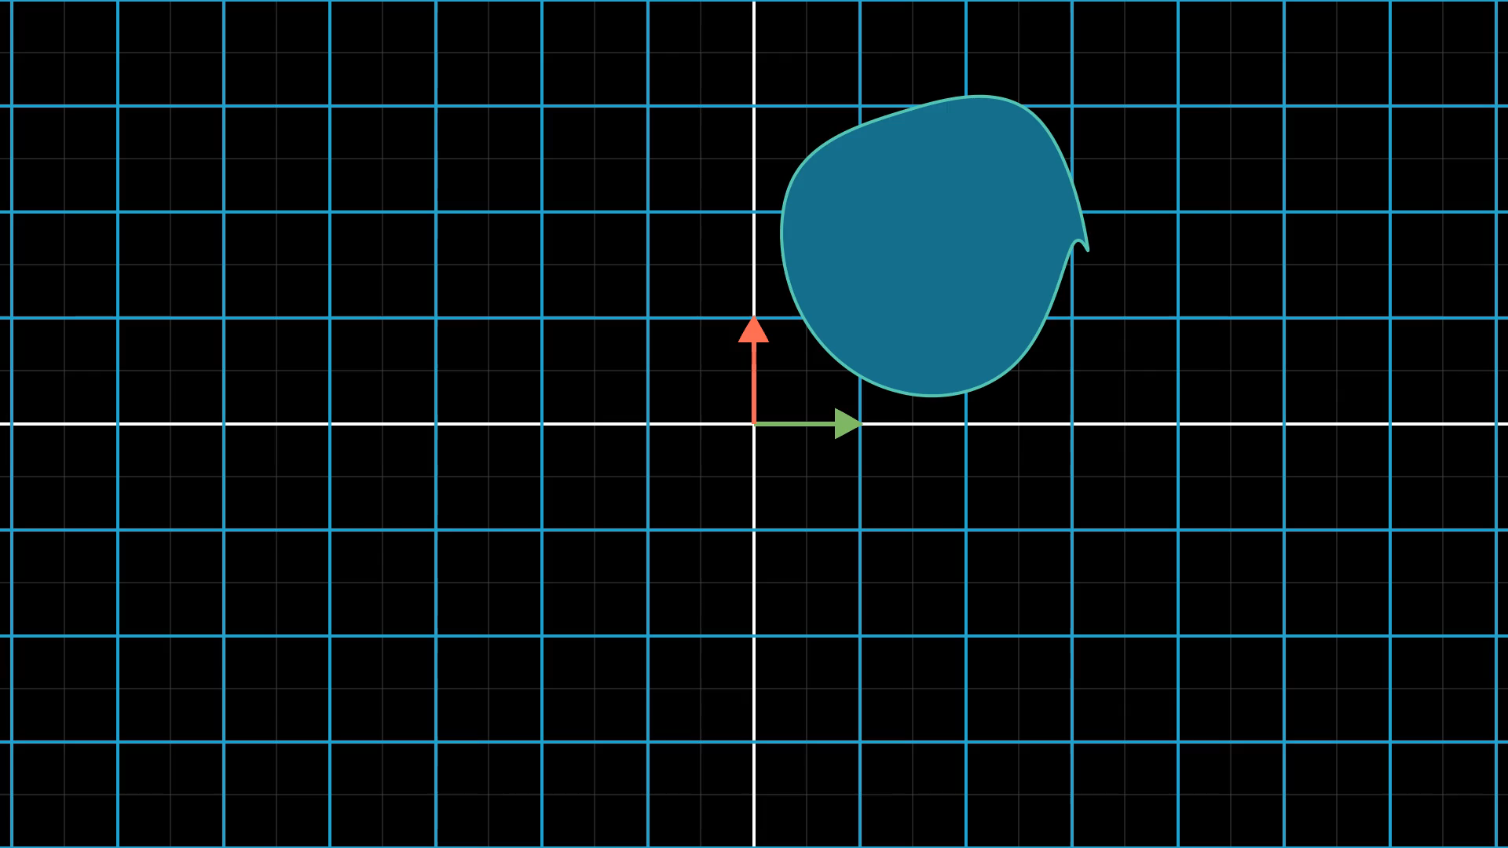
Notes:
Breaking blob into grid squares

Slide 13


Slide 14


Slide 15


Slide 16
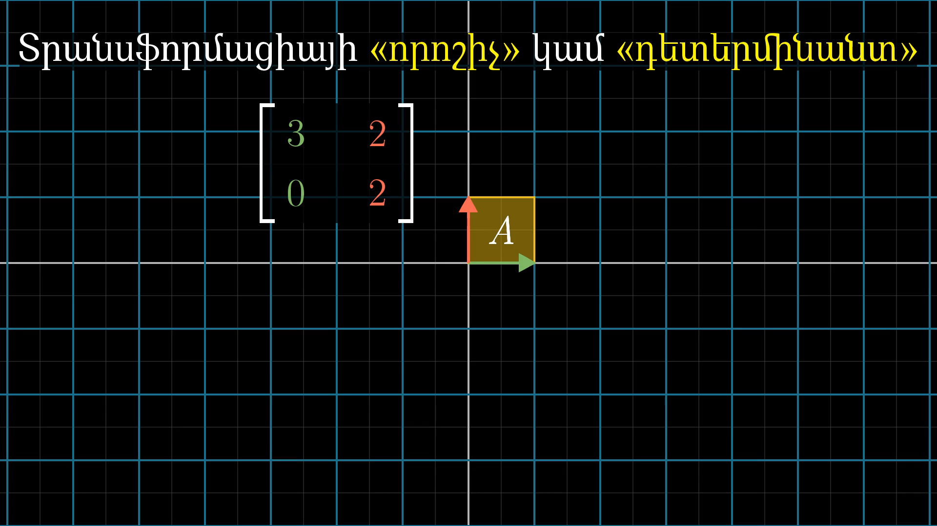
Notes:
Name determinant

Slide 17
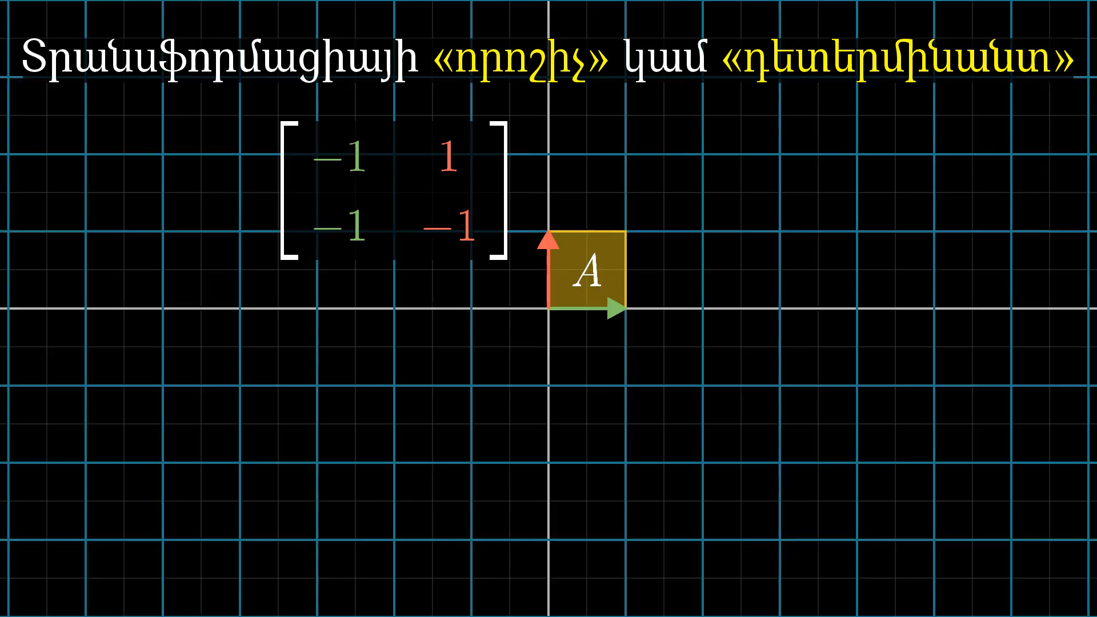
Notes:
Second determinant exammple

Slide 18
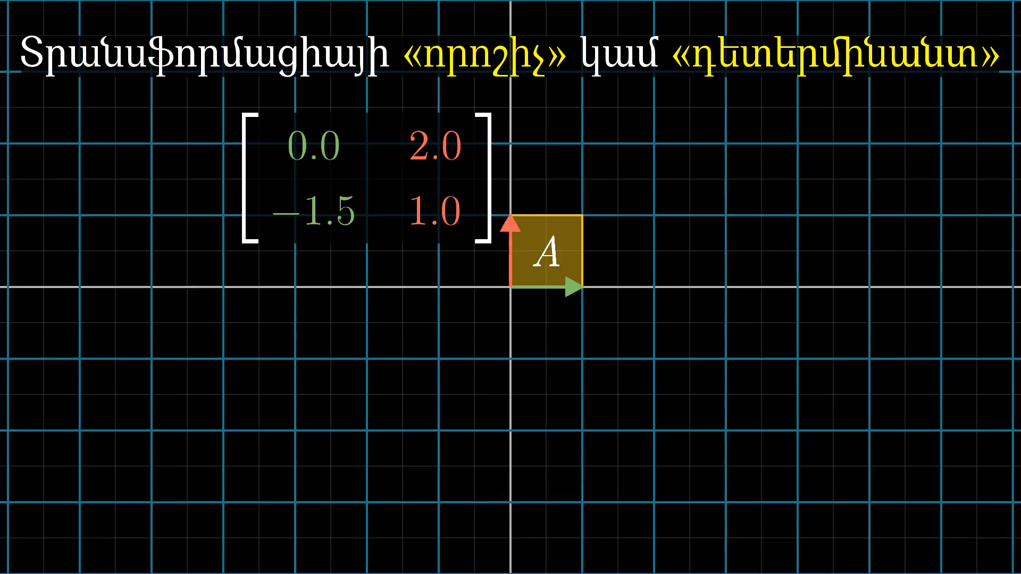
Notes:
Determinant is three

Slide 19
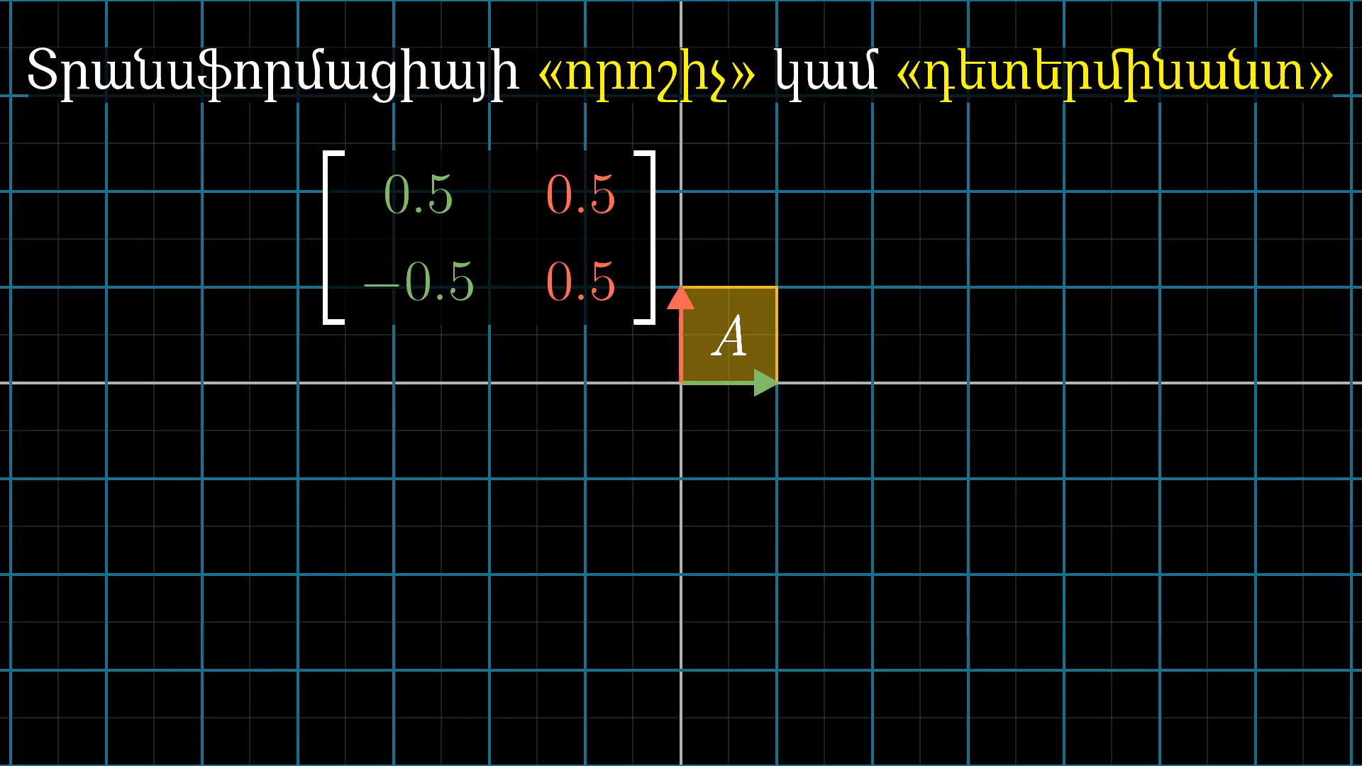
Notes:
Determinant is one half

Slide 20
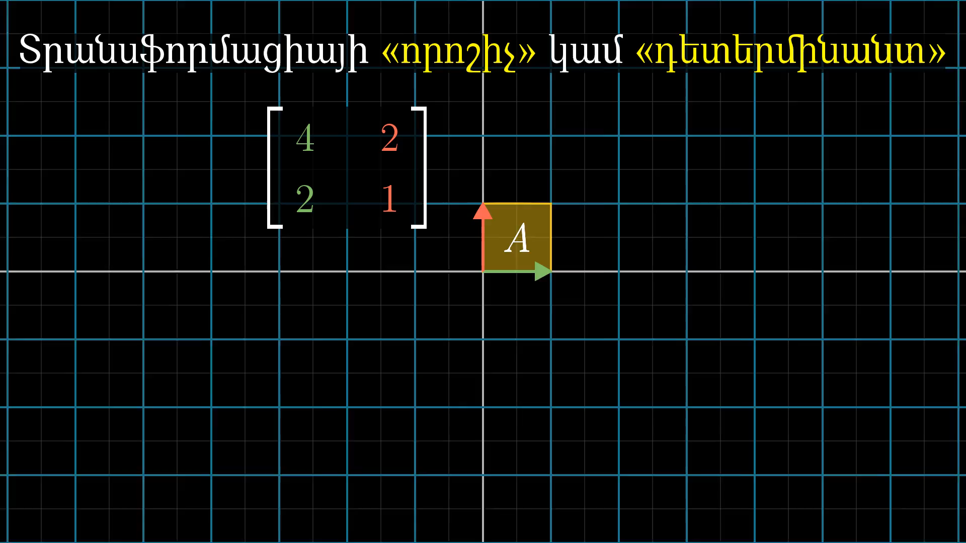
Notes:
Determinant is zero

Slide 21

Notes:
Second determinant is zero

Slide 22
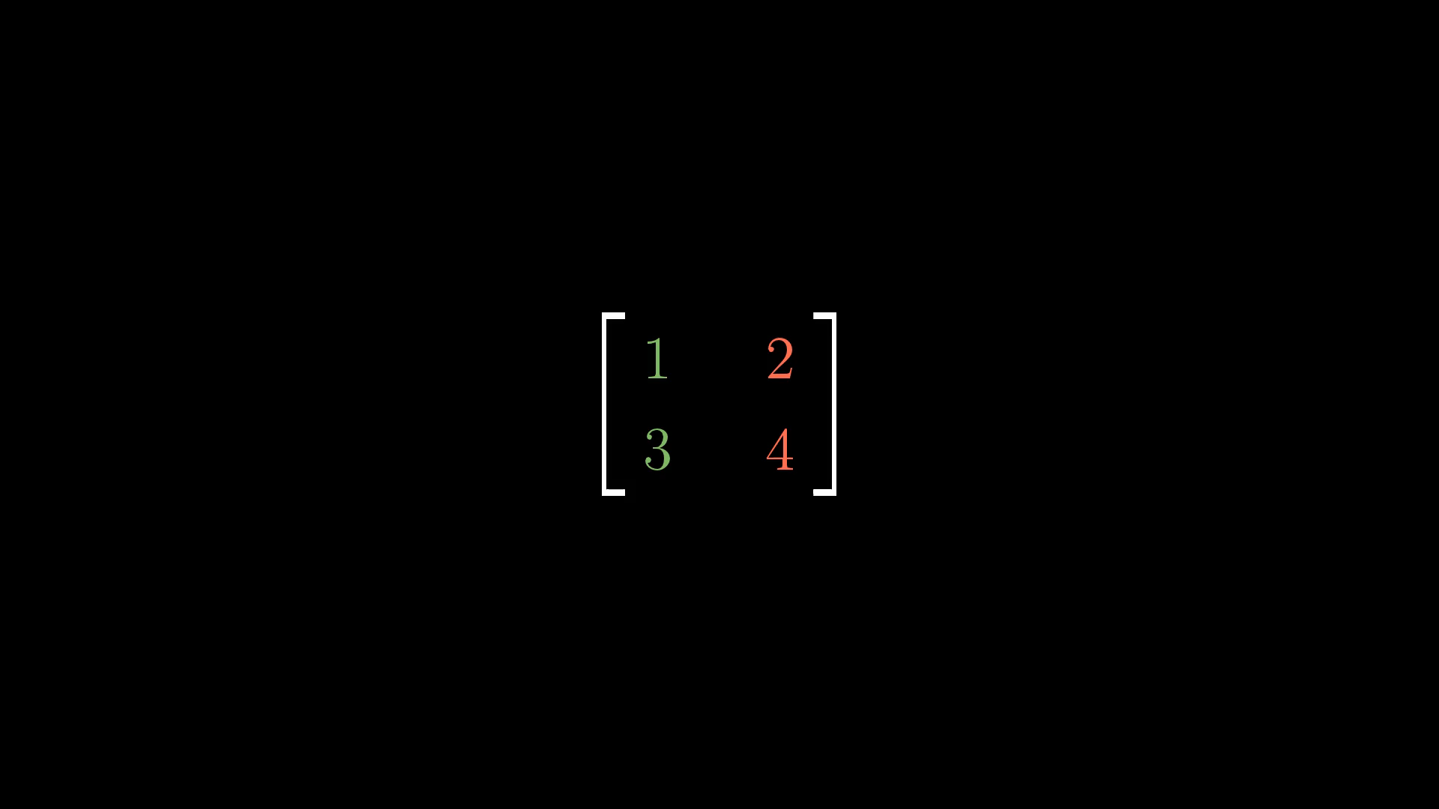
Notes:
Negative determinant

Slide 23
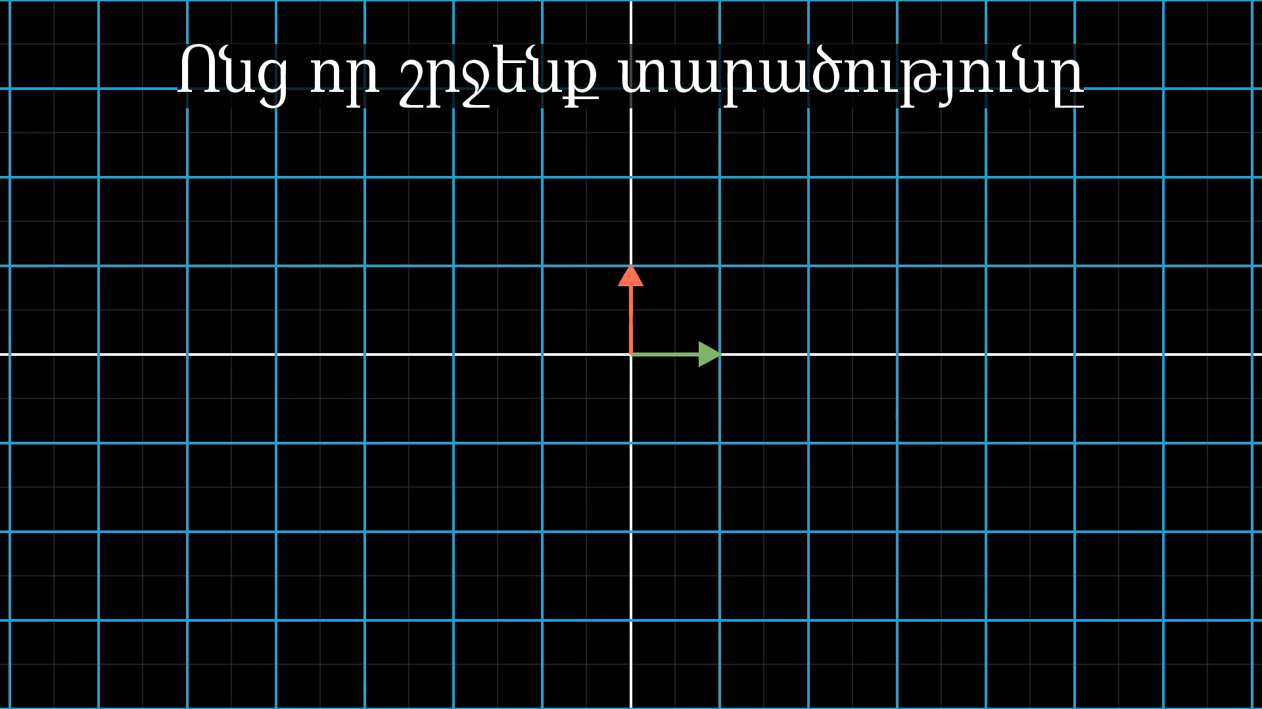
Notes:
Negative determinant transfrmation

Slide 24
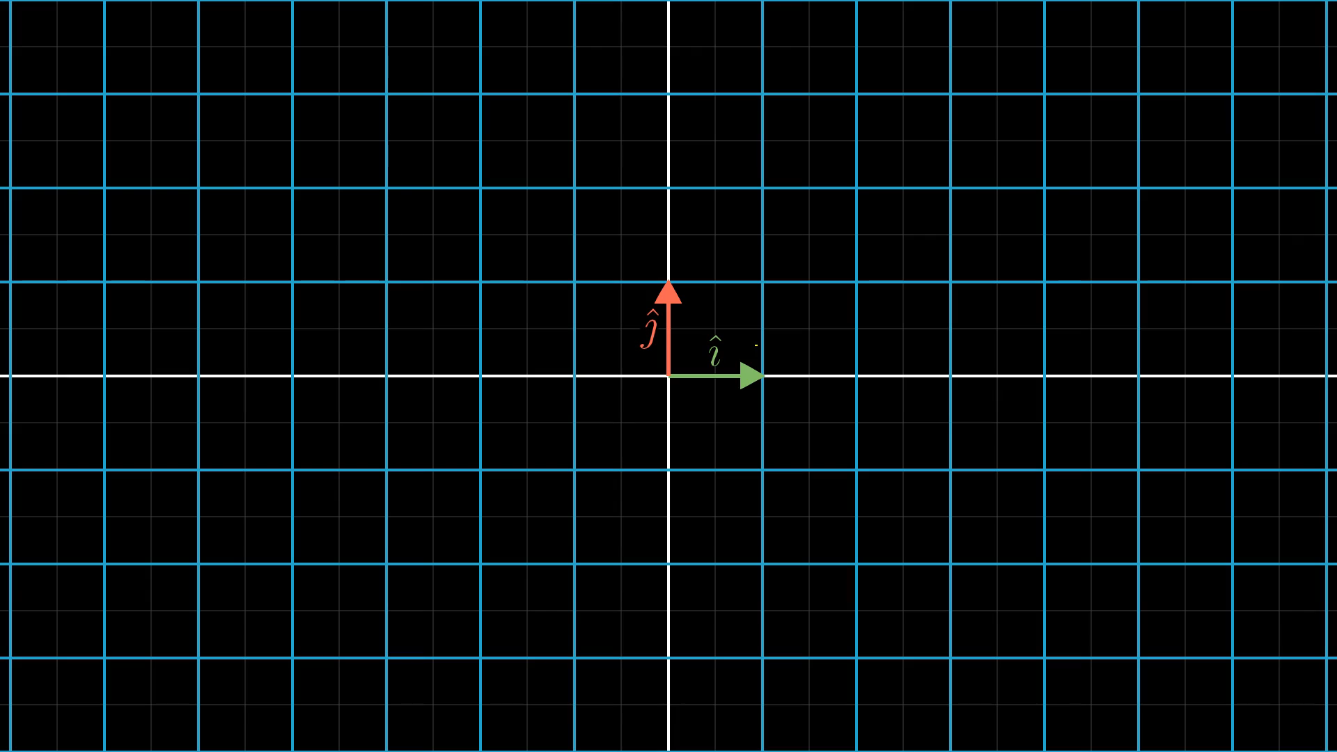
Notes:
I J orientation

Slide 25
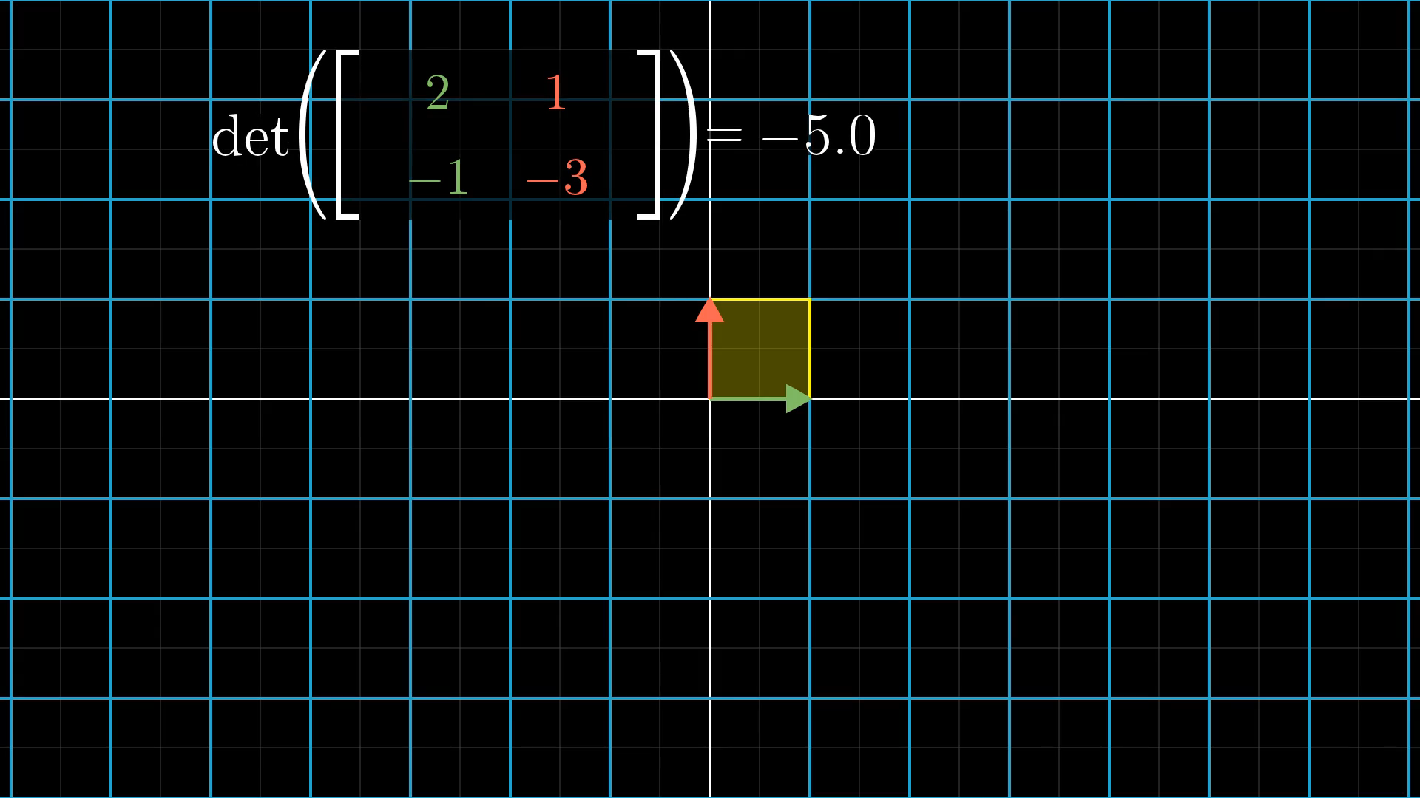
Notes:
Negative determinant example -5

Slide 26
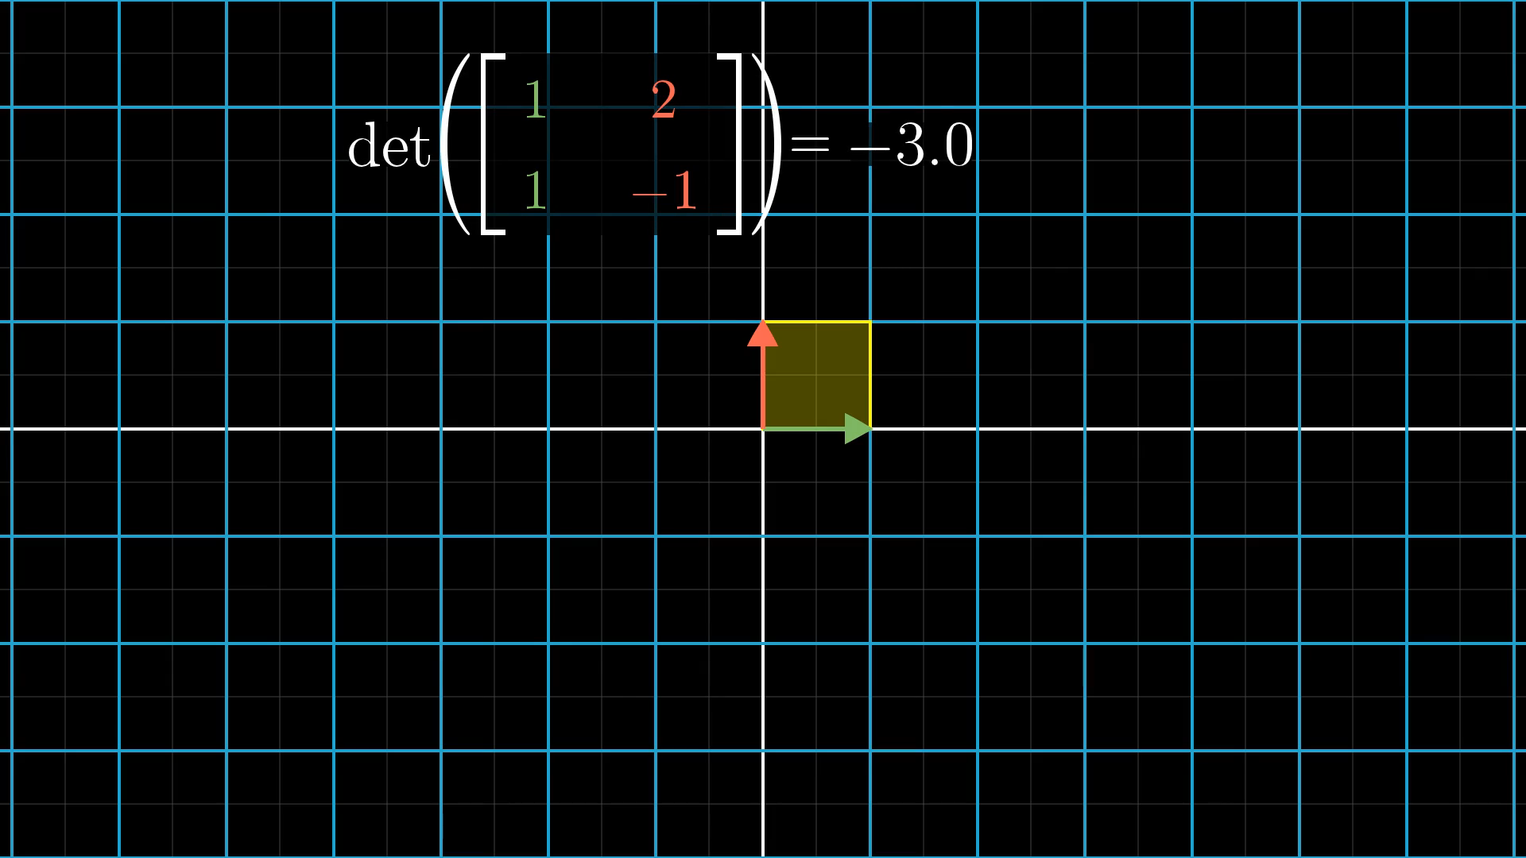
Notes:
Negative determinant example -3

Slide 27
Ի՞նչ կապ ունի բացասական դետերմինանտը տարածությունը շրջելու հետ
?
Notes:
Why negative scaling flip space over

Slide 28

Notes:
Flip space

Slide 29
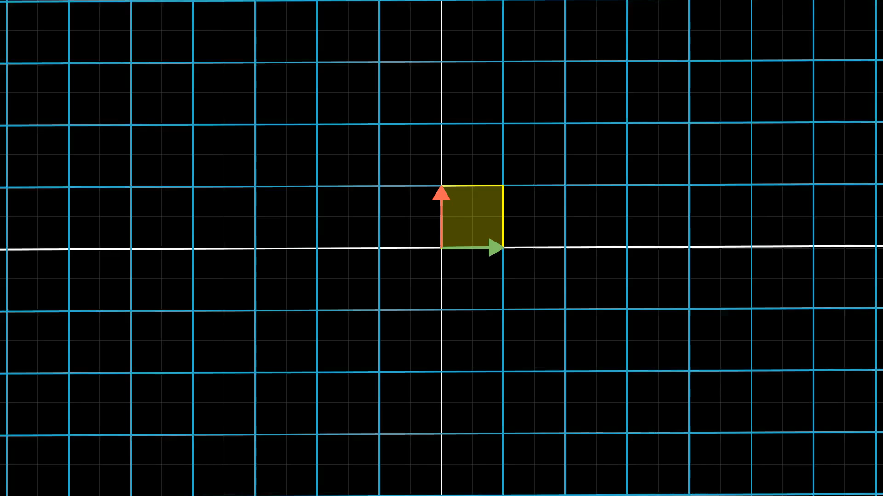
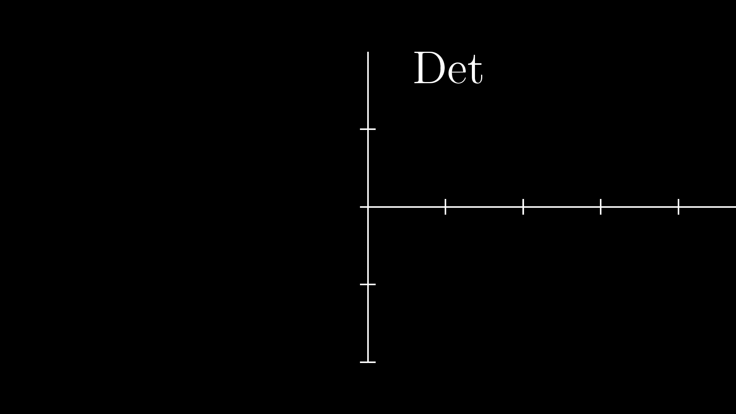
Notes:
Sowly rotate I hat

